Slide 1
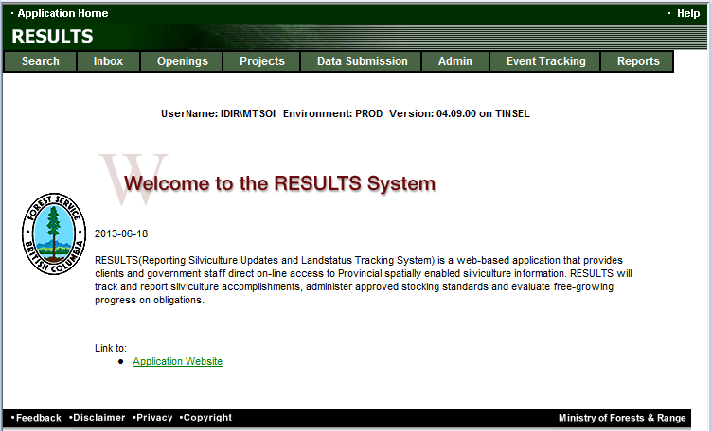
RESULTS Training
Core Module 6
Obligation Reporting
Standards Unit Modifications Online
Sept 2013

Slide 2
Table of Contents
Business Guidelines
Online or ESF Matrix
Technical documentation references
ESF Process
What kind of Plan?
    Corrections
    Minor Amendment
    S197
    Approved Variation
    Site Plan Amendment
    Amendment requiring Approval
    Inbox Approval
Auditing SU Modifications
Help Resources

Slide 3
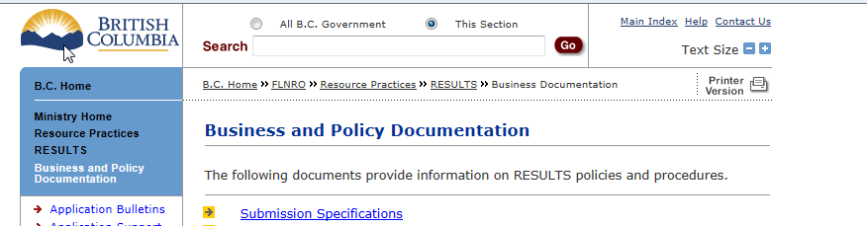
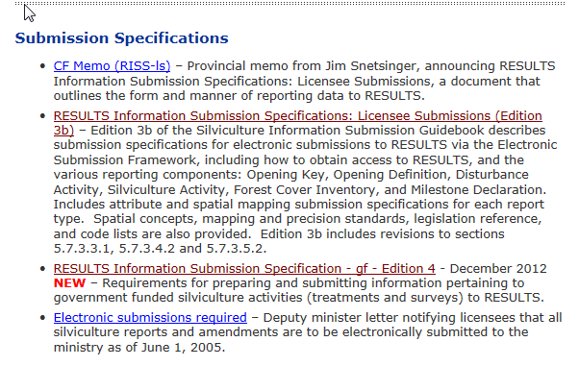
Business Guidance
http://www.for.gov.bc.ca/his/results/business.htm

Slide 4
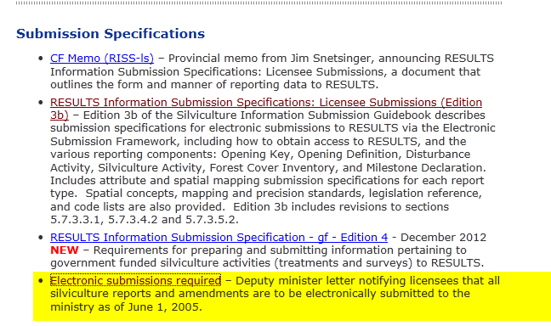
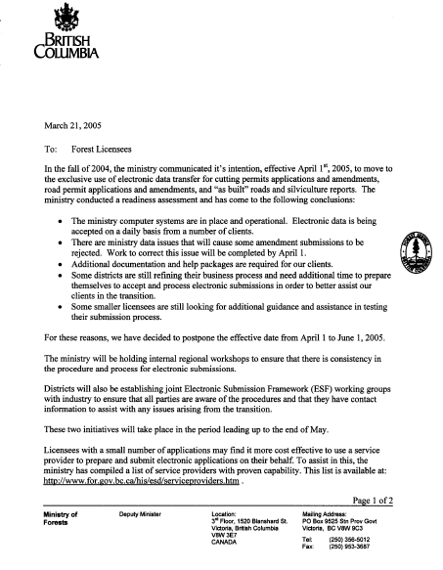
Mandatory ESF

Slide 5
Online or ESF Matrix
Submission Component | ESF | Online
\Opening Definition Tenure & Site Plan Information | Yes | No Opening and Standards Unit Spatial required
SU Modifications* | Yes | Conditional Must use ESF where there is changes to Standards Unit (additions, deletions) or changes in spatial.
Disturbance | Yes | Yes
Silviculture Activity | Yes | Yes Mandatory ESF for government funded activities (FE, JS)
Forest Cover * | Yes | No Forest Cover Spatial required
Milestone | Yes | Yes
s.108 Application | No | Yes
* Any spatial requirements must be submitted by ESF

Slide 6
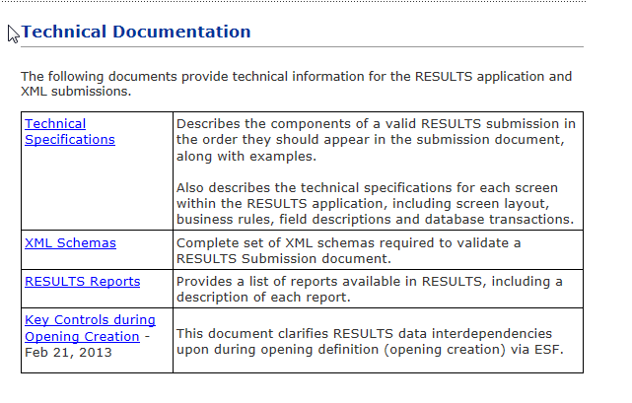
Technical Documentation References http://www.for.gov.bc.ca/his/results/techDocs.htm

Slide 7
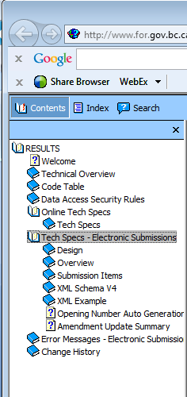
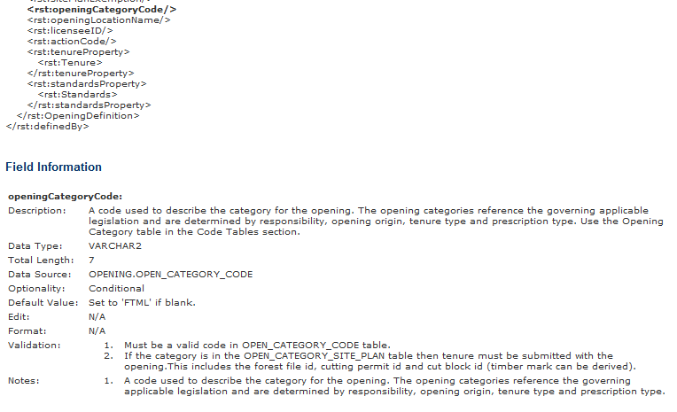
Technical Documentation ESF Schema References
http://www.for.gov.bc.ca/his/results/techDocs.htm
Tech Specs has ESF Reference with business rules and field specific edits.
Reference is by schema item.

Slide 8
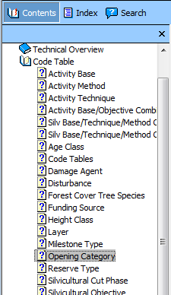
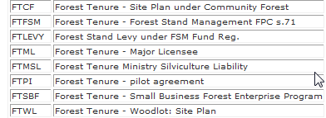
Technical Documentation Codelists http://www.for.gov.bc.ca/his/results/techDocs.htm

Slide 9


RESULTS - Process
SU Modification – two methods
Online Application (attribute only¹)
Silviculture Prescription
Site Plan

Slide 10
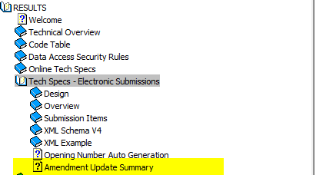
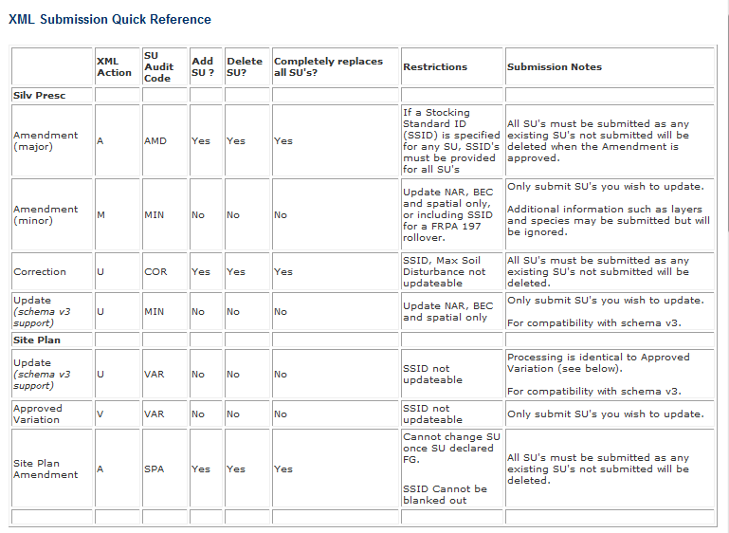
Technical Documentation SU Modifications Cheatsheet
http://www.for.gov.bc.ca/his/results/techDocs.htm
Helps explain setup for ESF portion
“A” , “U” and “V” actions with inclusion or omission of SU implies addition or removal of SUs!

Slide 11
RESULTS –ESF Submission
(must adhere to rules)
Rules are based on when the record was created
Did it have existing spatial (after RESULTS Opening Spatial Conversion creation date 2005-04-01)
For desired Action, must ensure that rules are followed.
Examples:
Correction, Major Amendments, Site Plan Amendment – all SUs must be submitted with the required intended corrections/amendment, any existing SUs not submitted will be deleted.
Minor & Approved Variation – can only submit the SU you intend to update
See technical documentation amendment matrix for Amendment Update Summary

Slide 12
RESULTS –Spatial Rules
Spatial Rules
Not required if Opening Approved (Creation date) is before 2003-12-01 RESULT Production release date
Not required if Spatial information exist and was prior to 2005-04-01 (RESULTS Opening Spatial Conversion)
Not Required for Minor Amendment when only BEC and NAR is updated.
Not required if not specified in Opening Spatial Requirement
Current requirements for spatial is in Opening Spatial Requirement: FTML, FTLEVY, FTFSM, FTSBF, FFTFLTC, FFTITSL, FTMSL.
Where amendments impact location/shape of SU boundaries, document must be provided with spatial data

Slide 13
RESULTS – General Process
Who | Process
Submitter | What type of Plan?
 | What type of Change?
 | Make Changes & provide any supplemental information
 | Submit / Save Changes
MOFR Approver | Review to Approve or Not Approve

Slide 14
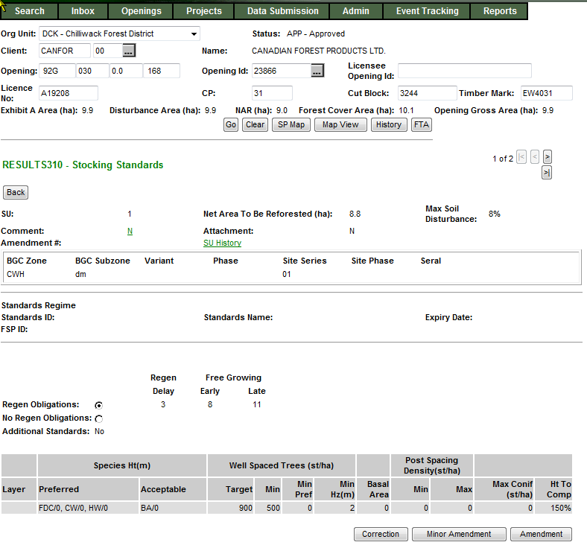
RESULTS – 1) What type of Plan?
Silviculture Prescription
S310 Stocking Standards
No Standards ID
Applies to ML Silviculture Prescription or WL Site Plan

Slide 15
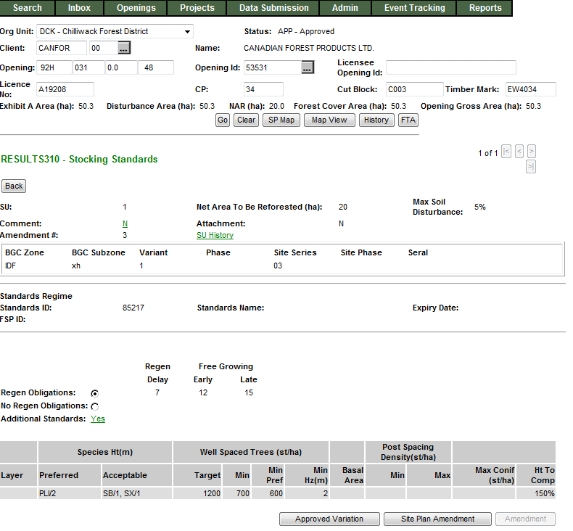
RESULTS – 1) What type of Plan?
Site Plan
S310 Stocking Standards
Standards ID exists
Applies to ML Site Plan or Woodlot Pre-Harvest Maps, and FFT Treatment Prescriptions

Slide 16
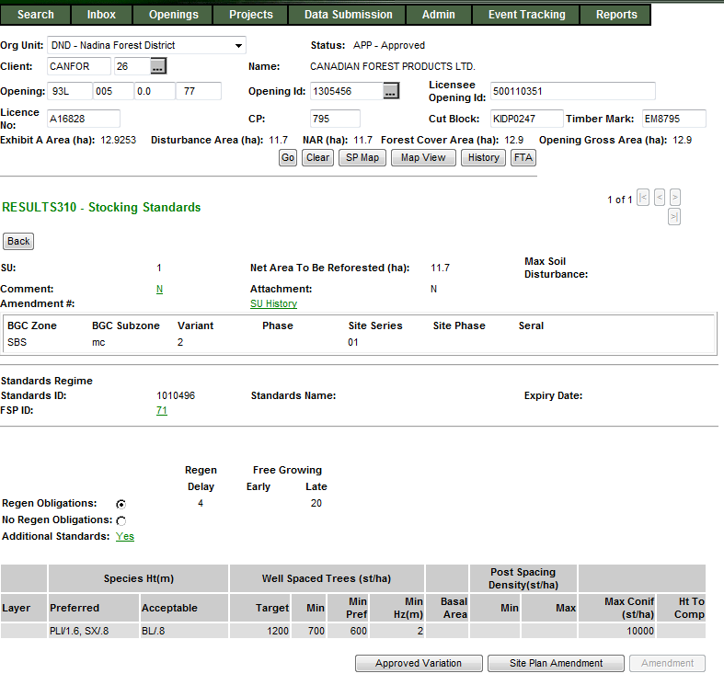
RESULTS – 1) What type of Plan?
FSP Site Plan
S310 Stocking Standards
Standards ID exists
Applies to ML Site Plan where the Standards ID is associated with FSP
Link exist to view details about FSPTS if have authorization

Slide 17

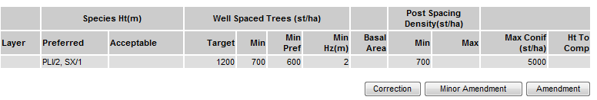
RESULTS – 2) What type of change?
Silviculture Prescription
  Corrections (for correcting paper-based pre-ESF records)
  Minor Amendments (No Approval Required)
  S197 (No Approval Required)
  Major Amendments (Approval Required)

Slide 18
RESULTS – 2) What type of change?
Silviculture Prescription
  Corrections (for correcting paper-based pre-ESF records)
  Minor Amendments (No Approval Required)
  S197 (No Approval Required)
  Major Amendments (Approval Required)

Slide 19
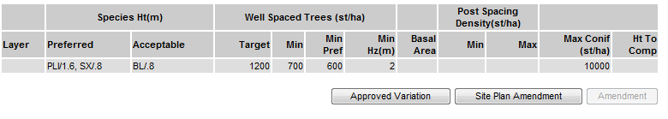
RESULTS – 2) What type of change?
Site Plan
Approved Variations (No Approval Required)
  S197 (No Approval Required)
Amendments (No Approval Required)

Slide 20

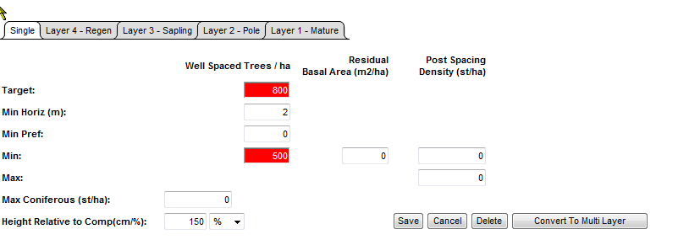
RESULTS – 3) Make Changes (online)
Silviculture Prescription Amendment Highlights changes
Silviculture Prescription – Corrections, Minor Amendment, s197
Site Plan – Approved Variation, s197 and Site Plan
Will not highlight changes – Accepted upon Save/Submission.

Slide 21
RESULTS – 4) Submit and Save
Silviculture Prescription Amendment - Submit for Approval
Silviculture Prescription – Corrections, Minor Amendment, s197
Site Plan – Approved Variation, s197 and Site Plan
Will not highlight changes – Accepted upon Save/Submission.

Slide 22
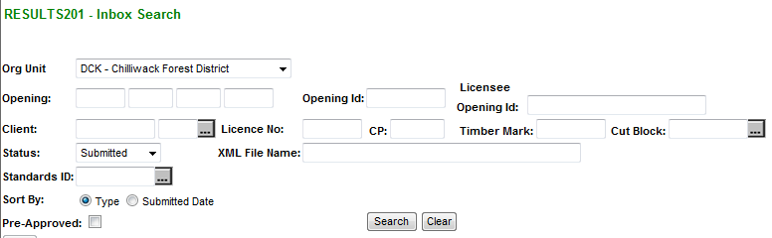

RESULTS – 5) Major Amendment Processing
Ministry approver to check RESULTS Inbox for proposed amendments
- Review proposed amendment
- Approved or Not Approve the proposal in the Inbox.

Slide 23
RESULTS – SU Modifications
Walkthrough Individual
SU Modification Actions

Slide 24
RESULTS – Corrections
Business
  Intended to correct opening SUs entered during paper-based data entry (records pre-mandatory ESF prior to June 1, 2005)
  Corrections are to reflect legal approved documents that exists.
  Older records do not have online SP Maps (unless converted through RESULTS Opening Spatial Conversion process) and therefore making changes not require spatial; but you can always include (but then must be via ESF)

Slide 25
RESULTS – Corrections
Online function
Save as you go – SU is separated into sections:
  SU identification with BEC & Offsets
  Density information
  Preferred species & Ht
  Acceptable species & Ht
  Rationale
  Any changes to any of these section must be saved.
  Saving is accepting the data as entered.
SS ID is not updatable
Toggle to any of the SU for changes as required.
System does not highlight changed items– upon Save, data will be modified. “Back” out of the S311. Repeat steps for other SUs, if required.
All changes are audited via SU History and History

Slide 26
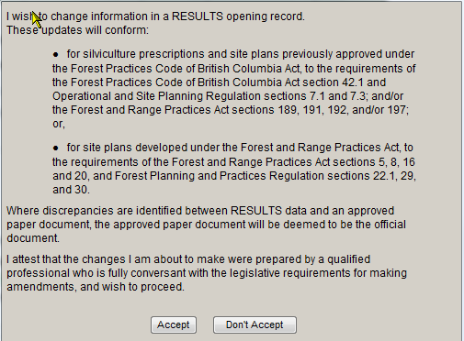
RESULTS – Corrections
Cannot proceed with Correction unless “Accept”

Slide 27
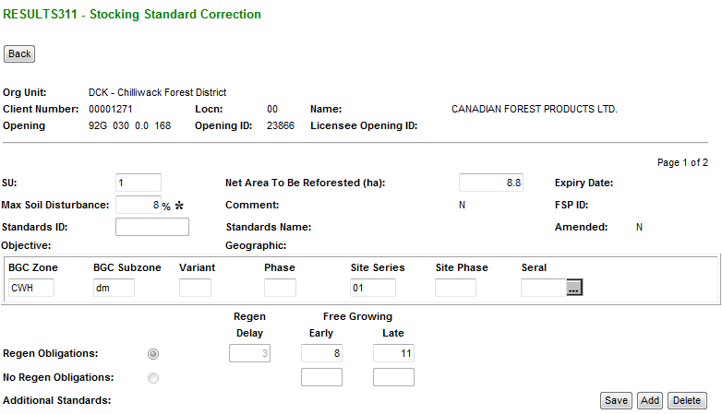
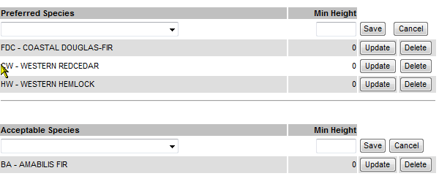
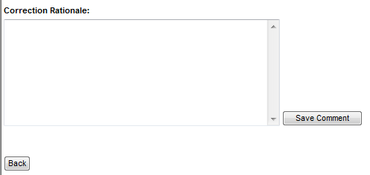
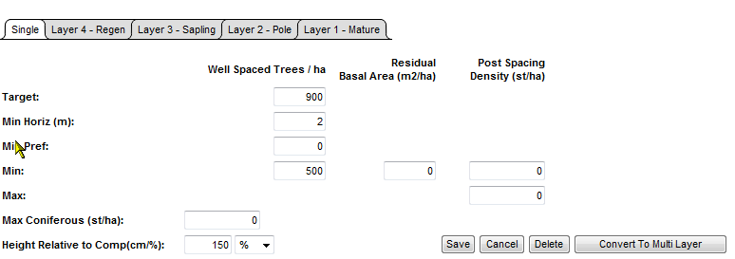
RESULTS – Corrections
Make changes to each of the required sections and
Save as you Go.
Standards ID is not updatable.
If regeneration declared, regeneration offset is not updatable
Select “Back” to finish Correction for the SU.
Repeat steps for Corrections other SU for the same opening

Slide 28
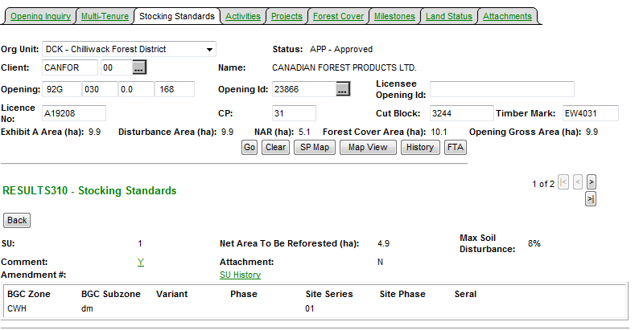
RESULTS – Corrections
SU History provides details of all SU modifications.
This function only existed as of March 11, 2008
Therefore any modifications prior to this date is not reflected.
Entire Opening’s SUs are
Copied with tracking of changed items.

Slide 29
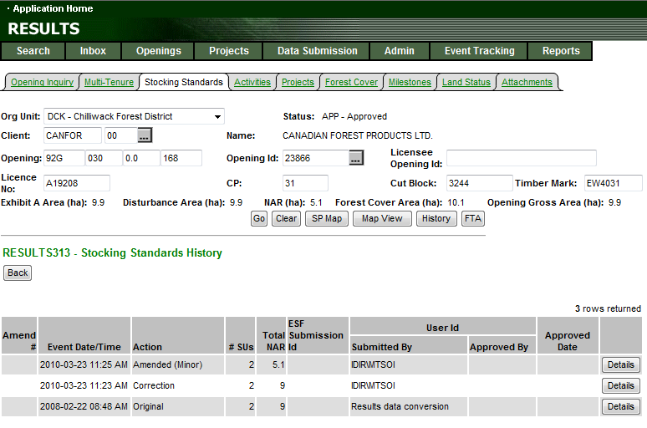
RESULTS – Corrections
All records will have either “O” original or “ES”
As the baseline condition
to use as basis for comparison

Slide 30
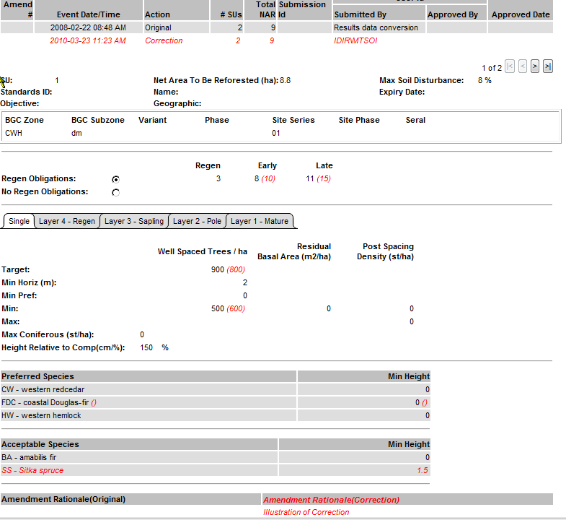
RESULTS – Corrections (SU History)
Changes associated with SU Modification Action
is in (red).
Can review all SUs associated with the Event.

Slide 31
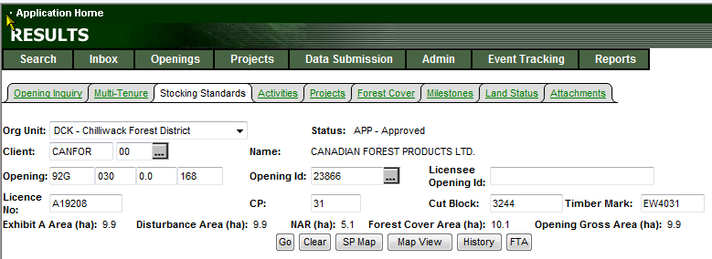
RESULTS – Corrections (SU History)
Tombstone “History” also tracks all changes and events on the opening.

Slide 32
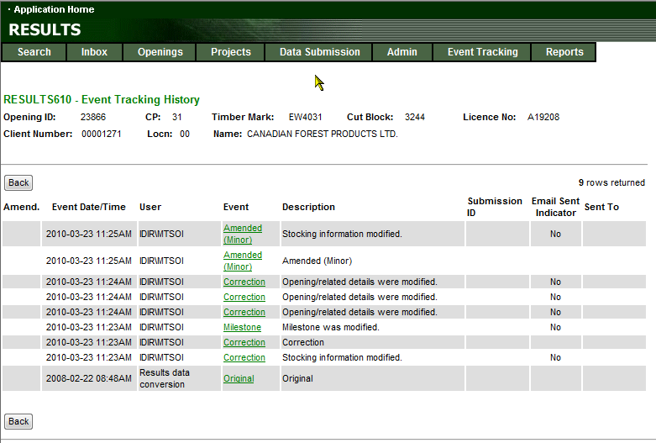
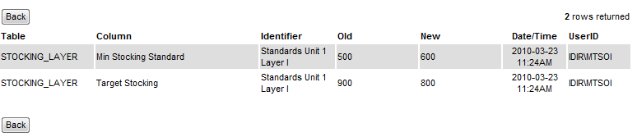
RESULTS – Corrections (History)
Contains all events and
Detailed screen provides
Information of data changed via “Old” and “New” columns

Slide 33
RESULTS – Minor Amendment
Business
  Intended for making area adjustments based on better information from field surveys.
Online function
Save as you go – SU is separated into separate sections:
  Only Net Area to be Reforested and BEC information maybe changed
  SS ID can be changed BUT tied to s197 rollover
  Rationale
  Any changes to any of these section must be saved for each section.
  Saving is accepting the data as entered.
Toggle to any of the SU for changes as required.
System does not highlight changed items– upon Save, data will be modified. “Back” out of the S311. Repeat steps for other SUs, if required.
All changes are audited via SU History and History

Slide 34
RESULTS – Minor Amendment
Cannot proceed with Minor Amendment unless “Accept”

Slide 35
RESULTS – Minor Amendment
Business
  Intended for making area adjustments based on better information from field surveys.
Online function
Save as you go – SU is separated into separate sections:
  Only Net Area to be Reforested and BEC information maybe changed
  SS ID can be changed BUT tied to s197 rollover
  Rationale
  Any changes to any of these section must be saved for each section.
  Saving is accepting the data as entered.
Toggle to any of the SU for changes as required.
System does not highlight changed items– upon Save, data will be modified. “Back” out of the S311. Repeat steps for other SUs, if required.
All changes are audited via SU History and History

Slide 36
Cannot proceed with Minor Amendment unless “Accept”

Slide 37
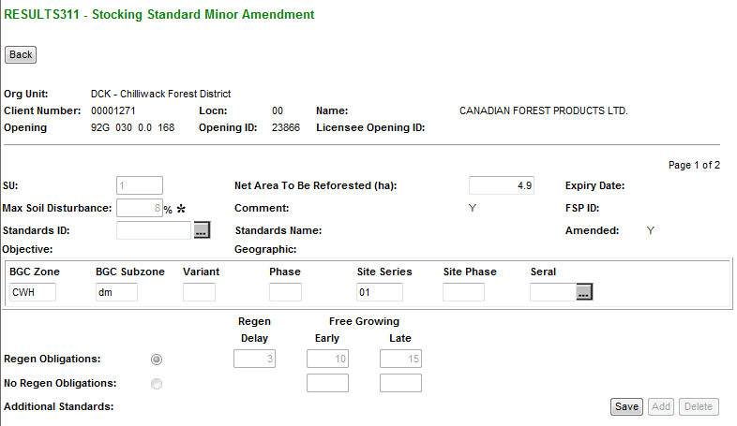
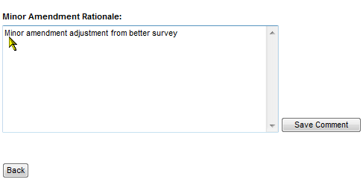
RESULTS – Minor Amendment
Make changes to each of the required sections and Save as you Go.
Net Area to be Reforested updatable
SS ID updateable but associated with s197 rollover
BGC information updatable
Select “Back” to finish Minor for the SU.
Repeat steps for Corrections other SU for the same opening

Slide 38
RESULTS – FRPA s.197
S197 rollover requires no approval required as it has been already approved under a FSP.
Online function
  Silviculture Prescription – “Minor”
  Site Plan (not FRPA) – “Site Plan Amendment”

Slide 39
RESULTS – FRPA s.197
Business
s.197 rollover requires no approval required as it has been already approved under FSP.
Standards Regime ID (SS ID) updatable and recognize as s197 rollover only if all of the following conditions are met:
Allowed for Silviculture Prescription or Site Plan not associated with a FSP
Standards ID being applied is associated with a FSP that has s197 Election Checked (“Y”) in the FSPTS
Standards ID belongs to the client and org unit for the FSP

Slide 40
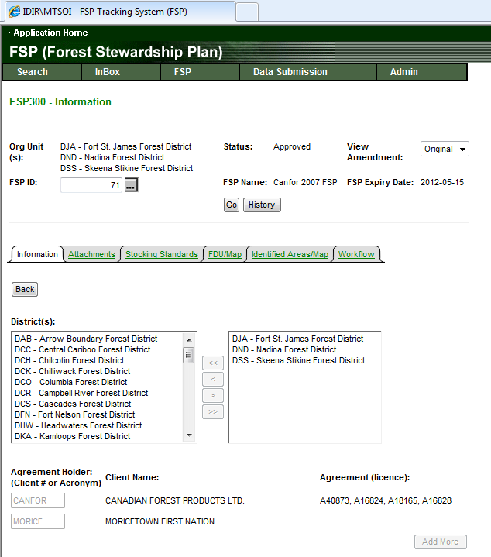
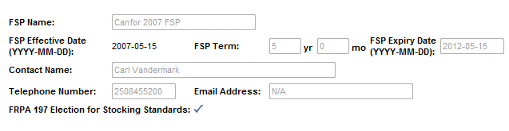
RESULTS – FRPA s.197
FRPA s197 Election must be made using FSPTS in order for s197 rollover to work in RESULTS

Slide 41
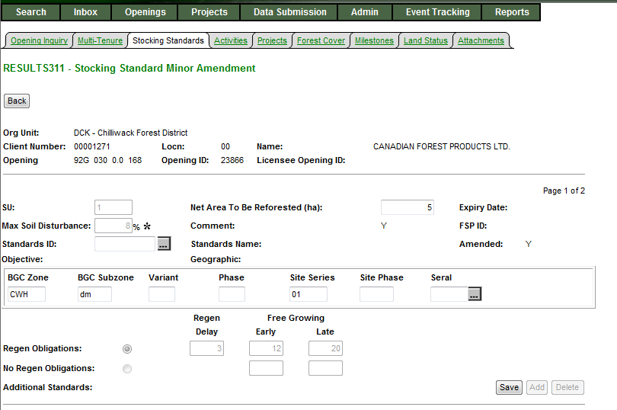
RESULTS – FRPA s.197
S197 rollovers will use
Minor Amendment
Enter Standards ID
To recognize as rollover, Standards ID must:
  Belong be associated with FSP with FRPA s197 Election checked in the FSPTS
  Standards ID must be approved
  Standards ID must belong to be authorized for use for district & client and exist in the FSPTS
Successful accepted rollover with be tracked as 197 Action Code.

Slide 42
Approved Variation
Business
  Intended for changes to stocking standards based on approved variations as per Forest Stewardship Plan.

Slide 43
Approved Variation
Online function
Save as you go – SU is separated into sections:
  SU identification with BEC & Offsets (Standard ID not available to change)
  Density information
  Preferred species & Ht
  Acceptable species & Ht
  Rationale
  Any changes to any of these section must be saved for each section.
  Saving is accepting the data as entered.
Toggle to any of the SU for changes as required.
System does not highlight changed items– upon Save, data will be modified. “Back” out of the S311. Repeat steps for other SUs, if required.
All changes are audited via SU History and History

Slide 44
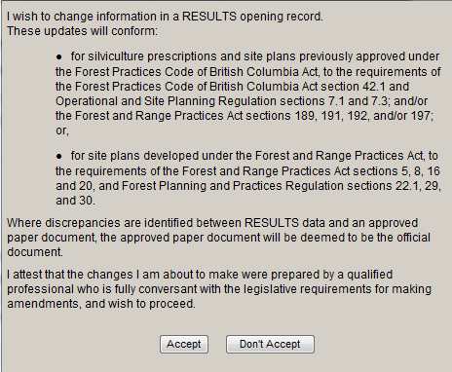
Approved Variation
Cannot proceed with Approved Variation unless “Accept”

Slide 45
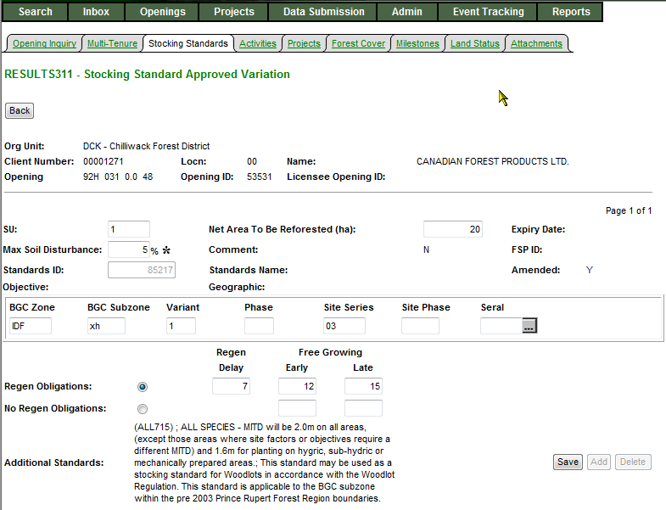
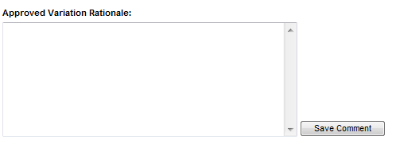
Approved Variation
Make changes to each of the required sections and Save as you Go.
Standards ID is not updatable.
Modify any portion of stocking standard as required to meet the required condition for the approved variation.
Select “Back” to finish Approved Variation for the SU.
Repeat steps for Approved Variation to other SU for the same opening
More sections exist but not included

Slide 46
Site Plan Amendment
Business
  Amendment to site plans – can add, delete or modify Standard Unit information and SS ID.

Slide 47
Site Plan Amendment
Online function
Save as you go – SU is separated into sections:
  SU identification with BEC
  SS ID updatable
  Rationale
  Any changes to any of these section must be saved for each section.
  Saving is accepting the data as entered.
Toggle to any of the SU for changes as required.
System does not highlight changed items– upon Save, data will be modified. “Back” out of the S311. Repeat steps for other SUs, if required.
All changes are audited via SU History and History

Slide 48
Site Plan Amendment
Cannot proceed with Site Plan Amendment unless “Accept”

Slide 49
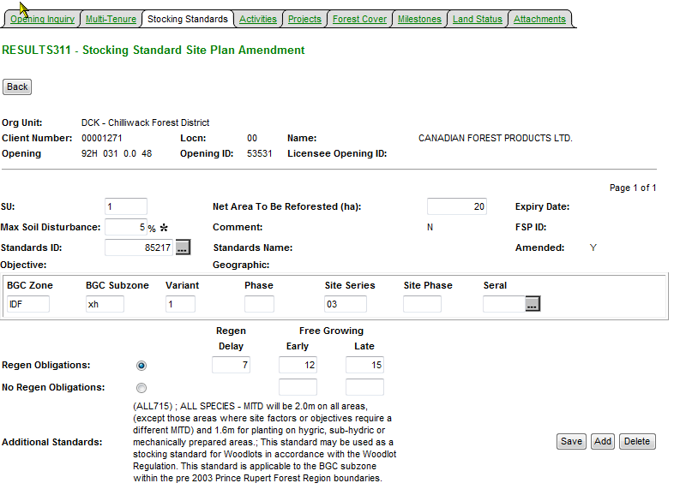
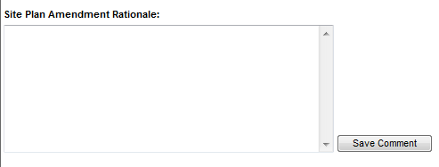
Site Plan Amendment
Make changes to each of the required sections and Save as you Go.
Standards ID is updatable.
Select “Back” to finish Site Plan Amendment for the SU.
Repeat steps for Site Plan Amendment to other SU for the same opening
More sections exist but not included

Slide 50
Silviculture Prescription Amendment (Requiring Approval)
Business
  Requiring changes to silviculture prescription.
Online function
  Save as you go – SU is separated into sections:
    SU identification with BEC & Offsets
    Density information
    Preferred species & Ht
    Acceptable species & Ht
    Rationale
    Any changes to any of these section must be saved for each section.
    Saving is accepting the data as entered.
  Toggle to any of the SU for changes as required.
  System highlights changed items in red in S312 screen.
  Opening Status is changed from “APP” to “AMD” – AMD is still draft amendment
  S310 shows Amendment Proposed.
  Must be Submitted to enable Inbox Processing.

Slide 51
Silviculture Prescription Amendment (Requiring Approval)
Cannot proceed with Amendment unless “Accept”

Slide 52
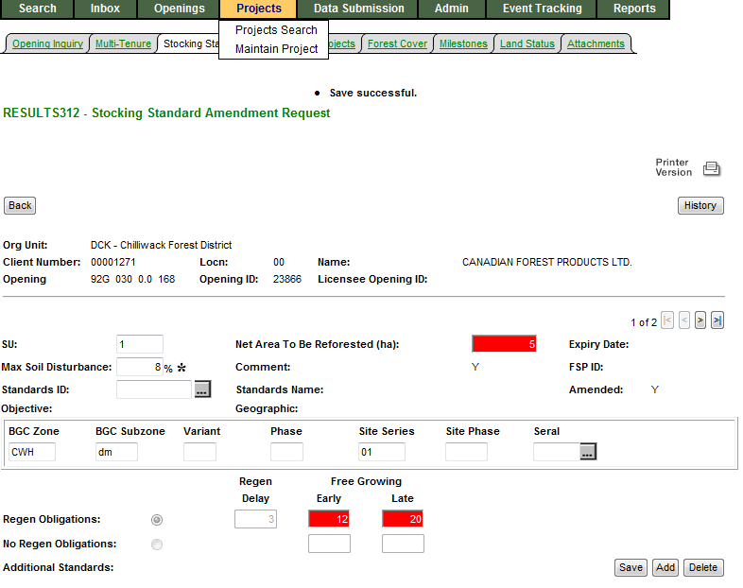
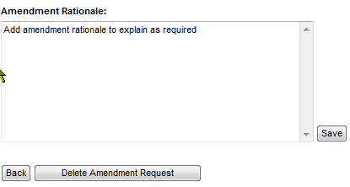
Silviculture Prescription Amendment (Proposed Amendment)
S312 – Any changes are made are highlighted in red.
S312 – has Delete to remove “Proposed Amendment”
More sections not shown but exists – need to save each section if there is requirement to make changes.
Can add or delete SU’s as needed.
Once complete Select – “Back” button
This is a proposed amendment - in “AMD” status – no action unless Submitted.
Can only Delete proposed amendment amendment via S312.

Slide 53
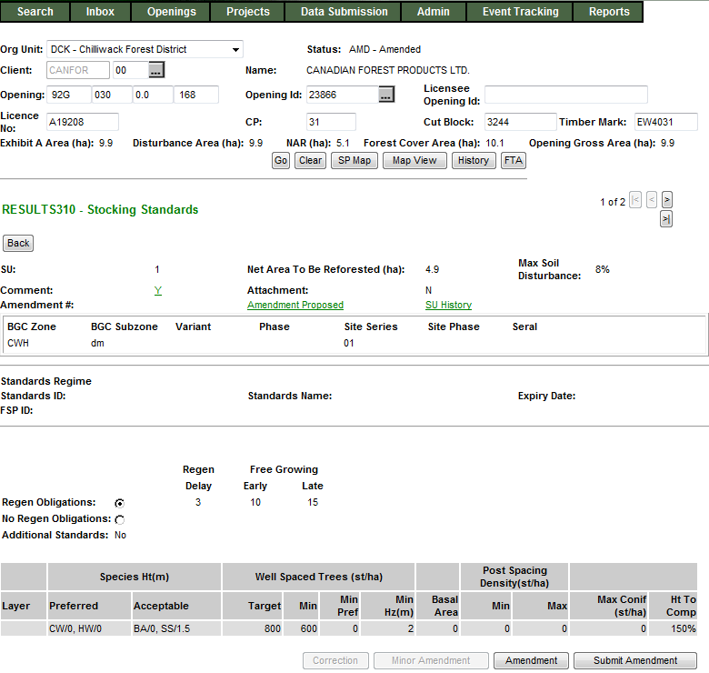
Silviculture Prescription Amendment (Proposed Amendment)
Status is in “AMD” status.
Can view or modify Amendment using Amendment Proposed
Once Proposed Amendment is ready, need to “Submit Amendment”.

Slide 54
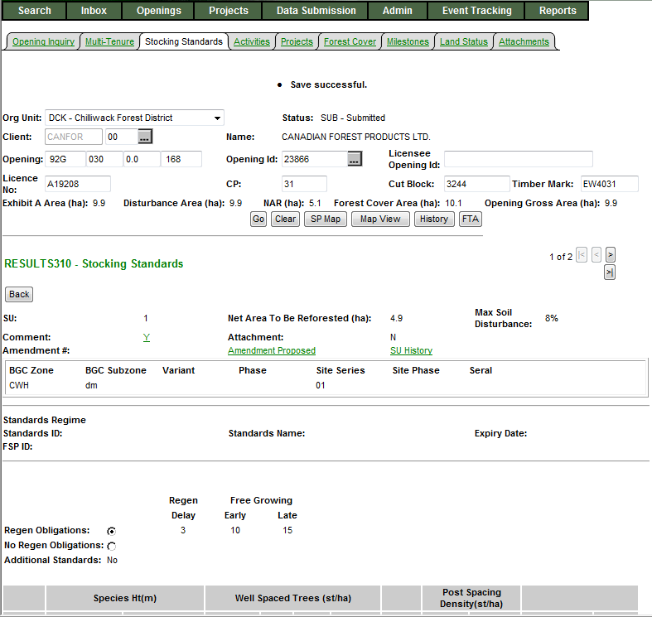
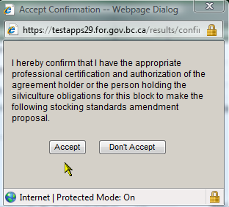
Silviculture Prescription Amendment (Submitted Amendment)
Must “Accept” confirmation to proceed with submitting Amendment for Approval.
If “Don’t Accept”, opening stays in “AMD”-Amended Status.
Once “Accept”, the opening changes to “SUB”-Submitted Status.
Note that the data in S310 is the same as the Proposed Amendment is submitted but not yet approved.,

Slide 55
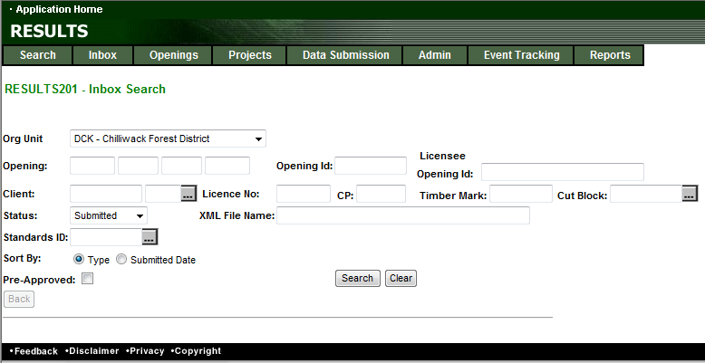
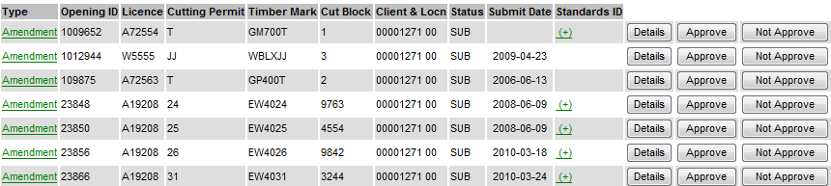
RESULTS –Amendment requiring approval
Inbox – RESULTS Approver role
S201 – Inbox Search
MOF personnel must have “Approver” role to action.
Set Status to “SUB” & Search
“SUB” status will not allow declaration and any attempt for any other SU modifications due to pending review.

Slide 56
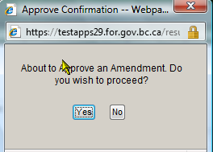
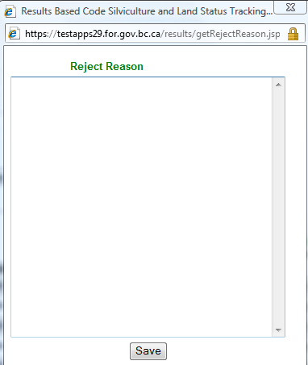
RESULTS –Amendment requiring approval
Inbox – RESULTS Approver role
S201 – Inbox Search
Ministry personnel must have “Approver” role to action.
Details Take to S310 – to enable review of Submitted Proposal.
Approve Will approve Submitted Amendment –
Opening will change from “SUB” to “APP” status
-----------------------------------------------------------------------------------------------------------------
Not Approver: Requires mandatory reason to explain reason for not approval.
Approve Opening change from “SUB” to “AMD”
Submitter: Make decision for next step:
Delete Amendment – change from “AMD” status to “APP” to start over
Modify existing Proposed Amendment to resubmit – change from “AMD” to “SUB”

Slide 57
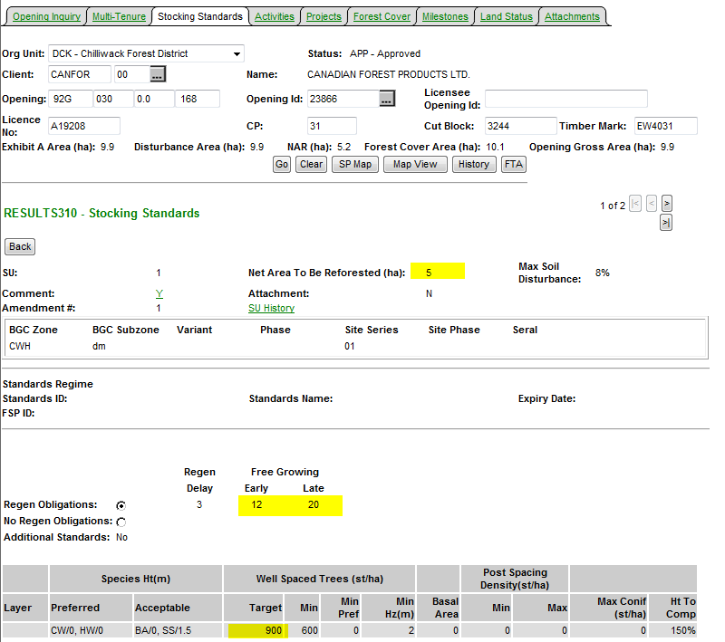
RESULTS –Amendment requiring approval
Inbox – Approved Opening
Upon Approval – Status changed to “APP”
All changes from the Amendment is now reflected current S310-Stocking Standards.
SU History & History contains Audited changes.

Slide 58
RESULTS – Major Amendment – Flow
Online
Approve
APP
AMD
SUB
APP
Changes reflected and audited
Not Approve
Submit
AMD
SUB
Delete
APP
ESF
Approve
APP
SUB
APP
Changes reflected and audited
Not Approve
AMD
No changes reflected
Submitter to respond
As required on their respective forest management system

Slide 59


Auditing – SU History
Upon Approval – Status changed to “APP”
All changes from the Amendment is now reflected.
SU History & History contains Audited changes.
Changes items from the Action is in (red).
Only has changes effective March 11, 2008 (date which this infrastructure was created)

Slide 60



Auditing – History
S610 History provides each of event.
SU History data can also be accessed from S610.
History provides tracking of individual element changed

Slide 61


Help Resources
http://www.for.gov.bc.ca/his/results/support.htm
http://www.for.gov.bc.ca/his/results/training/index.htm
E-Stand Enhancement

